Slide 1

Welcome
VisioMel Challenge: Predicting Melanoma Relapse
Machine Learning and Data Analytics for Industry 4.0 (MADI40) Seminar
Author: Mahadev Prasad Panda
Supervisor: Thomas Altstidl, M. Sc.

Slide 2
Agenda
01
Introduction
02
Data Description
03
Methodologies
04
Evaluation
05
Conclusion & Future Work

Slide 3
01 Introduction

Slide 4
Introduction
Definition
Melanoma
Notes:
What is Melanoma?
Melanoma is a cancer of the skin which develops from cells responsible for skin pigmentation, caused by ultraviolet rays.
High chance of relapse.
Melanoma diagnosis is a vital but difficult task.
Involves a pathologist assessing the risk of relapse based on characteristics of the cancerous tissue.

Slide 5
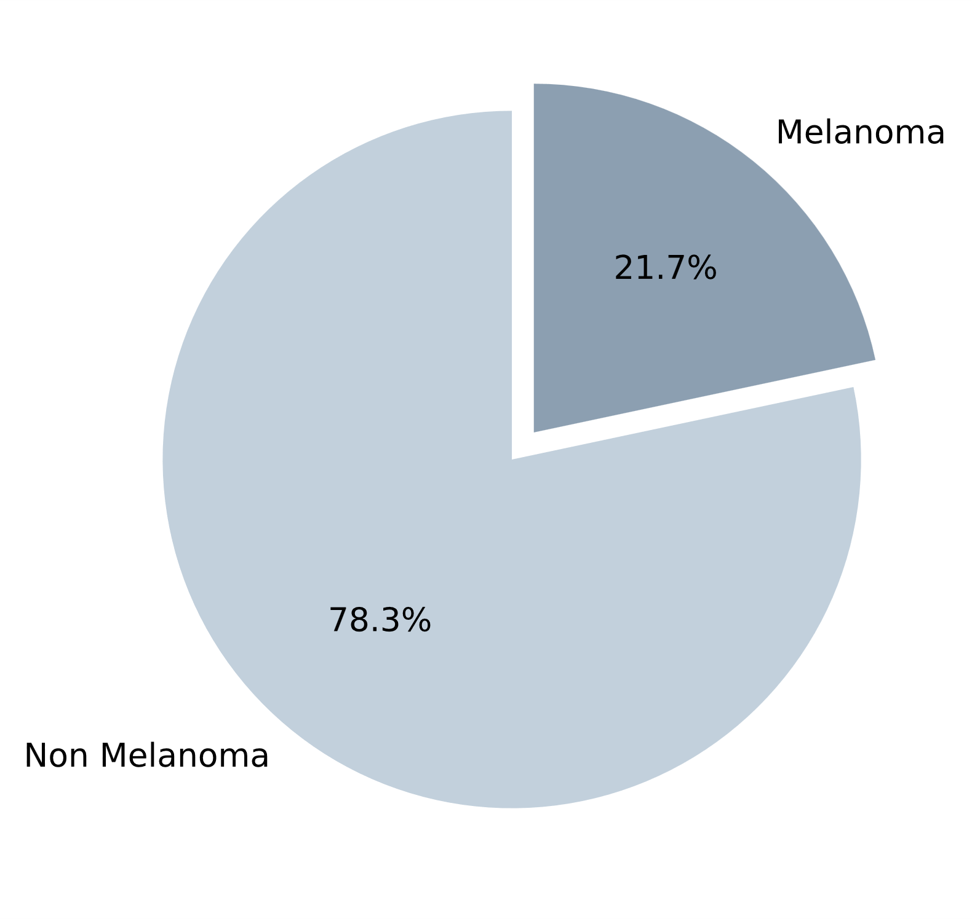
Introduction
Motivation
Share of Melanoma in total skin cancer cases (Source)

Slide 6
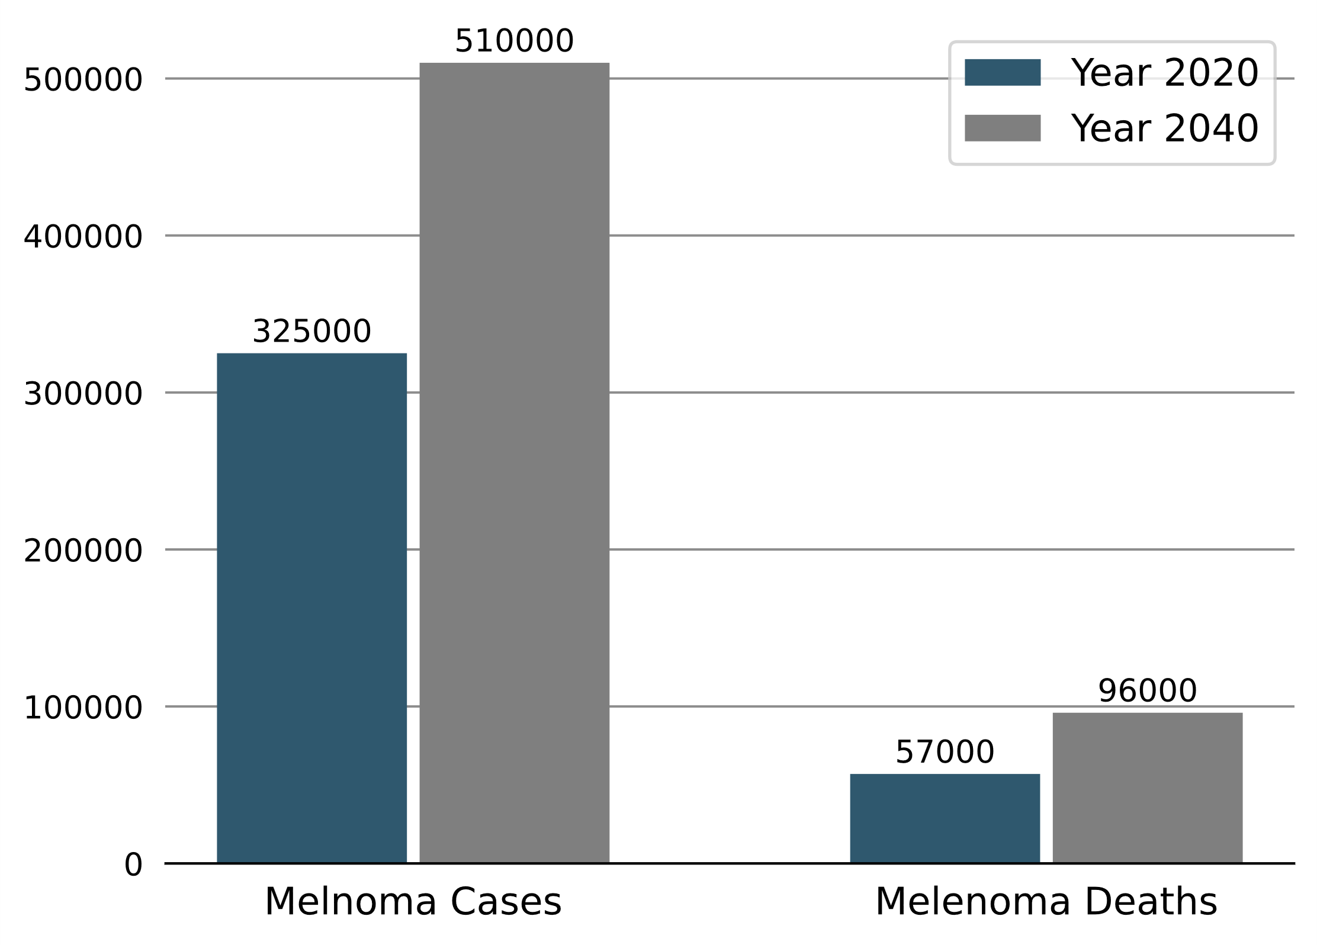
Introduction
Motivation
Share of Melanoma in total skin cancer cases (Source)
Melanoma number of cases and deaths (source)

Slide 7
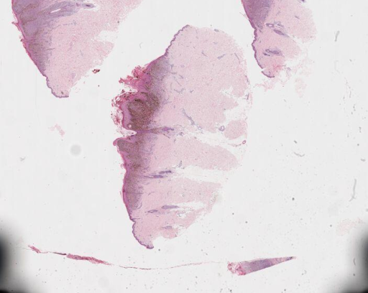


Introduction
Goal
5 Years
Model
Relapse
Yes/No

Slide 8
02 Data Description

Slide 9
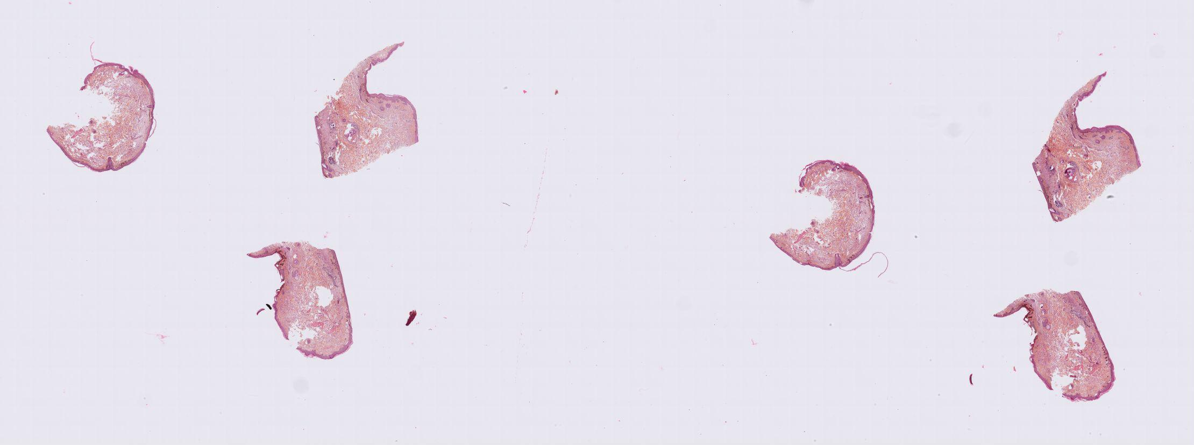
Data Description
Whole Slide Images (WSIs)
Whole slide images are digital formats of the microscopic glass slides

Slide 10
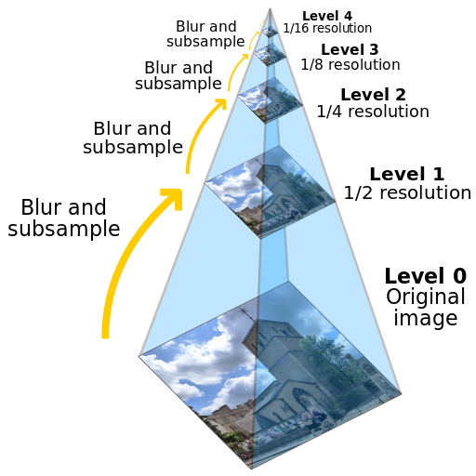
Data Description
Whole Slide Images (WSIs)
Whole slide images are digital formats of the microscopic glass slides
WSIs are in the form of pyramidal TIFs, which are a multi-resolution, tiled format.
An illustration of the multi-scale property of the pyramidal TIF image format. Source: link

Slide 11
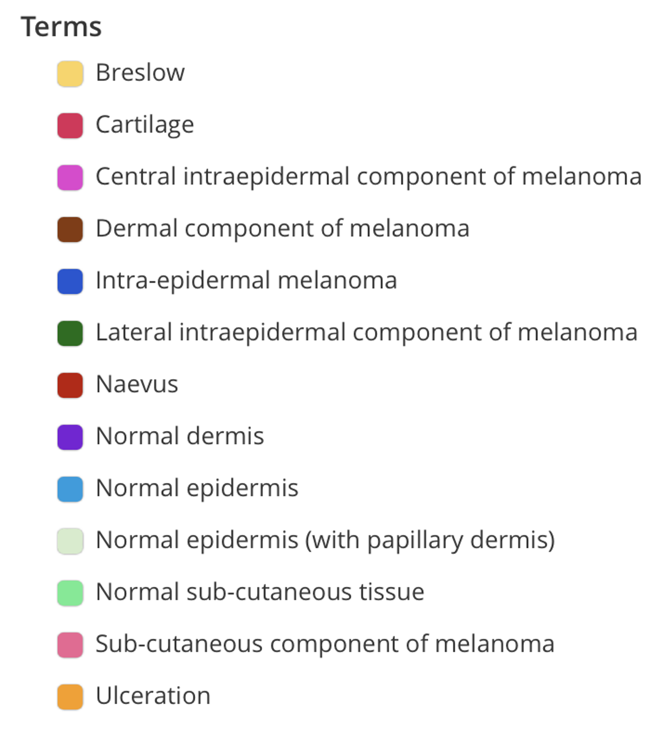
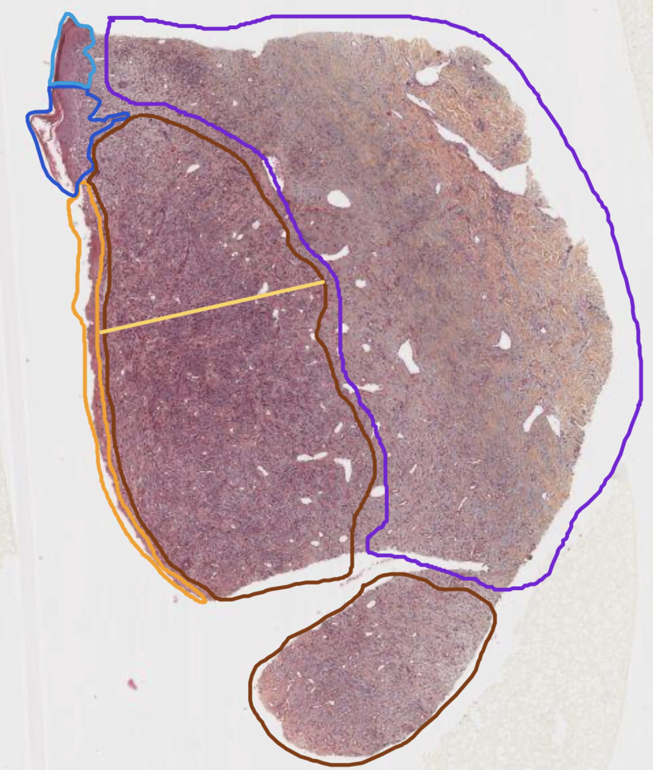
Data Description
Breslow and Ulceration Visualisation Example

Slide 12
Data Description
Meta Data
Metadata contains clinical variables collected from the patient at the time of initial diagnosis.
breslow (str) - thickness of the melanoma in mm at initial diagnosis
ulceration (str) - whether the melanoma had ulceration, which is a total loss of epidermal tissue
filename | age | sex | body_site | melanoma_history | breslow | ulceration
1u4lhlqb.tif | [32:34[ | 2 | thigh | YES | <0.8 | NO
nqazk74i.tif | [54:56[ | 1 | arm | YES | [2 : 4[ | YES

Slide 13
Data Description
Labels
The labels for this dataset come from patients' medical records
Indicate whether the patient was diagnosed with a melanoma relapse in the 5 years after initial diagnosis.
filename (str) - unique identifier for each patient
relapse (int) - whether there was a relapse, where 0=no relapse and 1=relapse

Slide 14
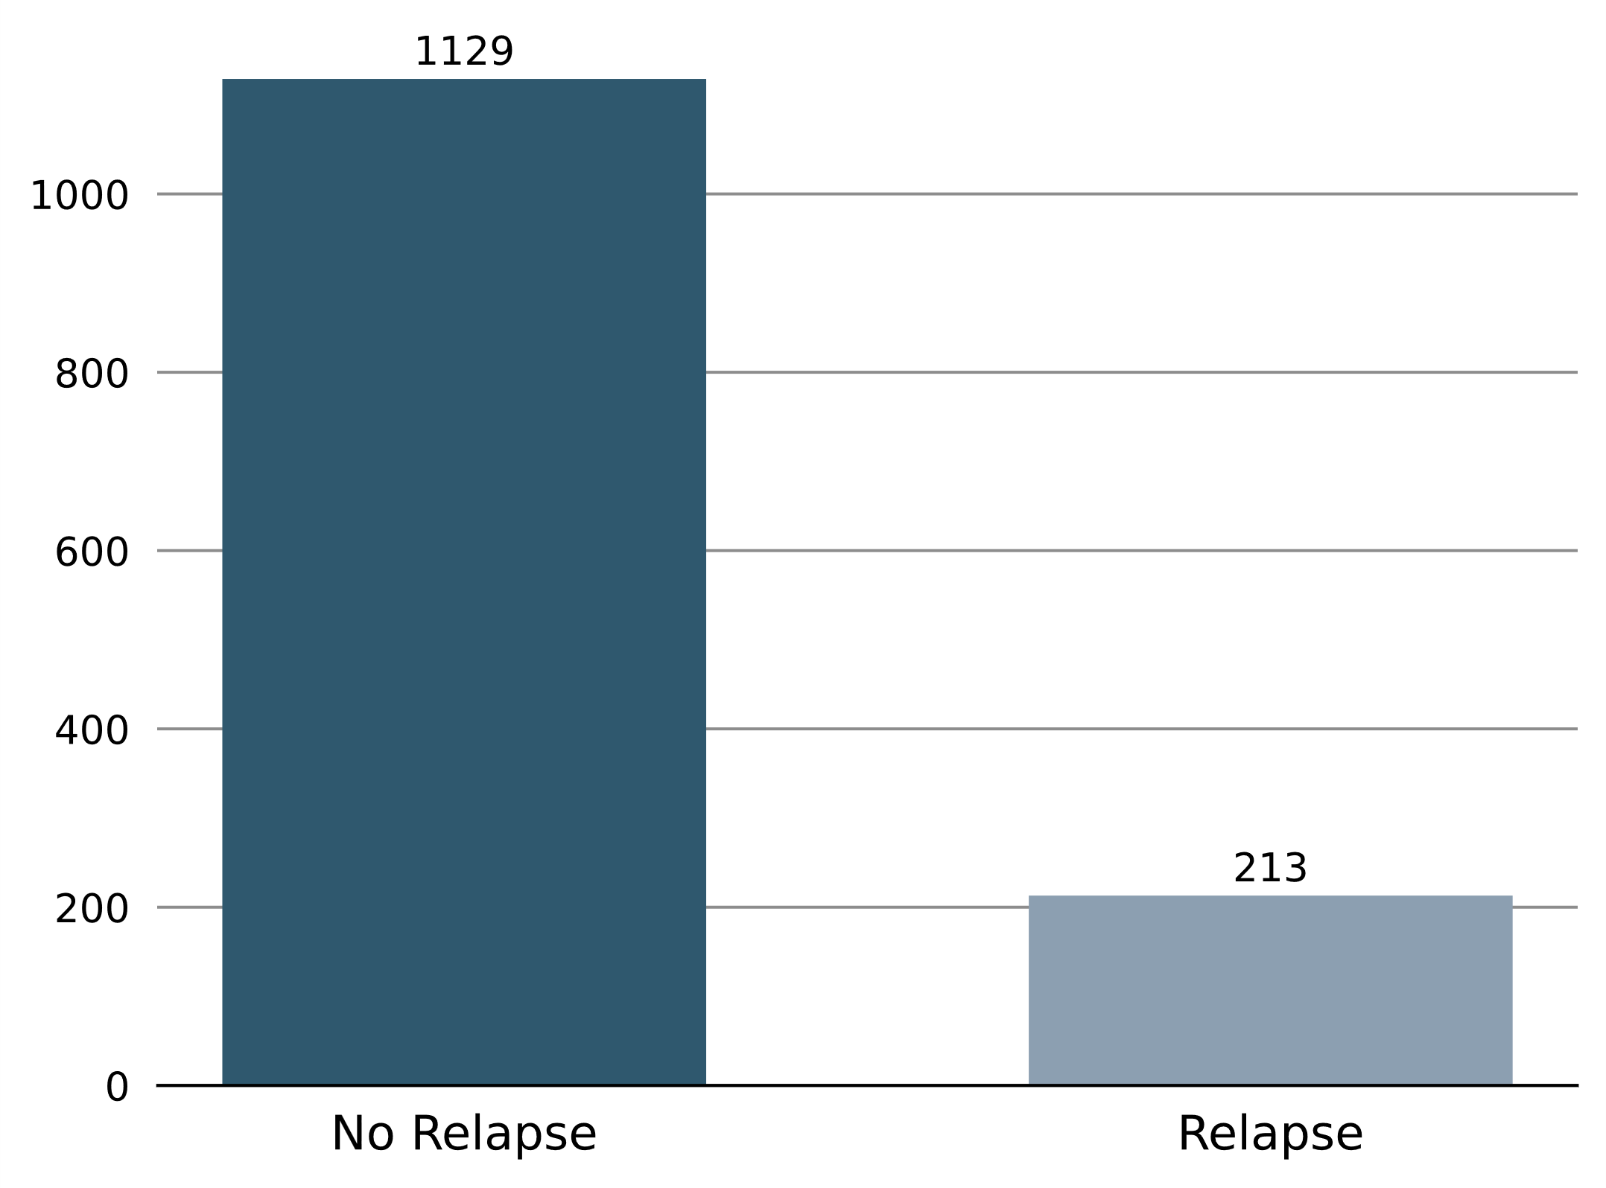
Data Description
Basic EDA
Highly imbalanced dataset
Total observations 1342
Observations without relapse 1129
Observations with relapse 213

Slide 15
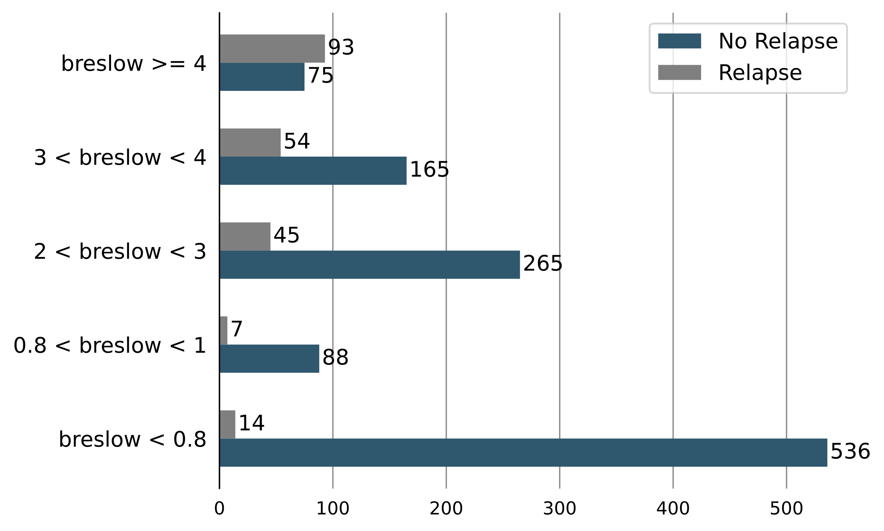
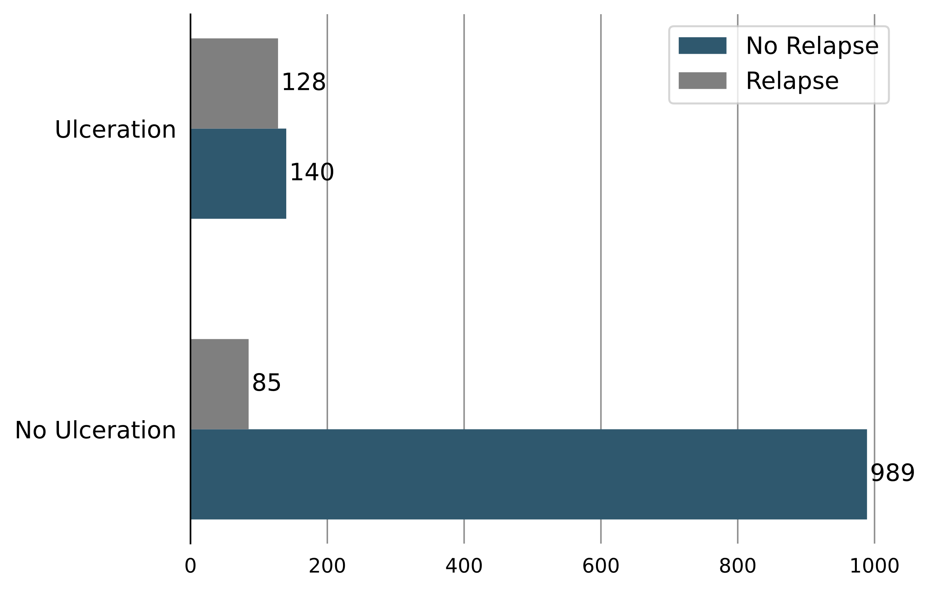
Data Description
Basic EDA
Data distribution over different Breslow width (in mm)
Data distribution over Ulceration

Slide 16
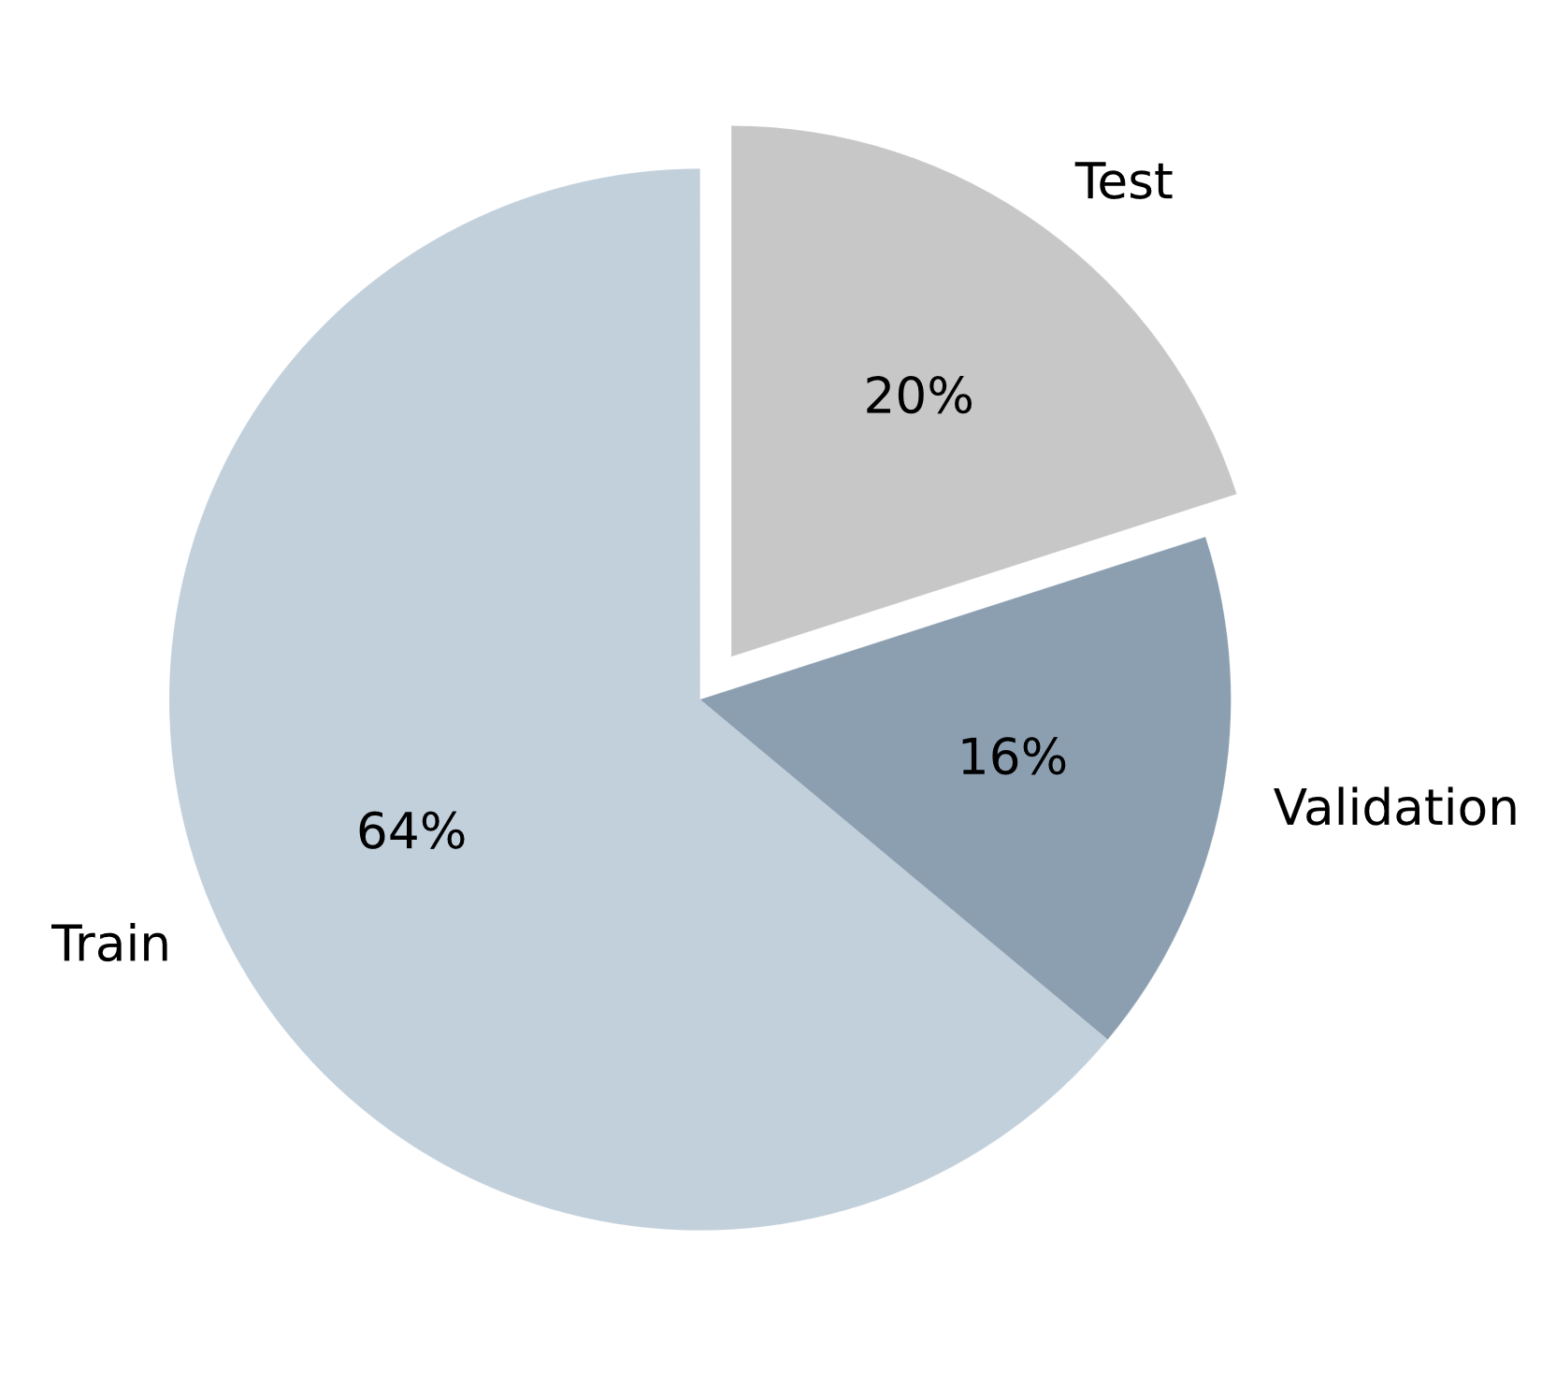
Data Description
Data Splits

Slide 17
03 Methodologies

Slide 18
Methodologies
Problem Statement and Research Questions
Problem Statement:
Predict relapse without using Breslow and Ulceration as input to model
Research Questions
Should we train with WSI and tabular data together (single stage) or one after the other (two stages)?
Should Patches from WSI be preferred over WSI for training?

Slide 19
Methodologies
Methods
Whole slide model (Deep Learning model using both WSI and meta data)
Single Stage
Two Stage
Patch based model (Deep Learning model using patches from WSI and meta data)
Single Stage
Two Stage
Base model (Machine Learning only using meta data)

Slide 20
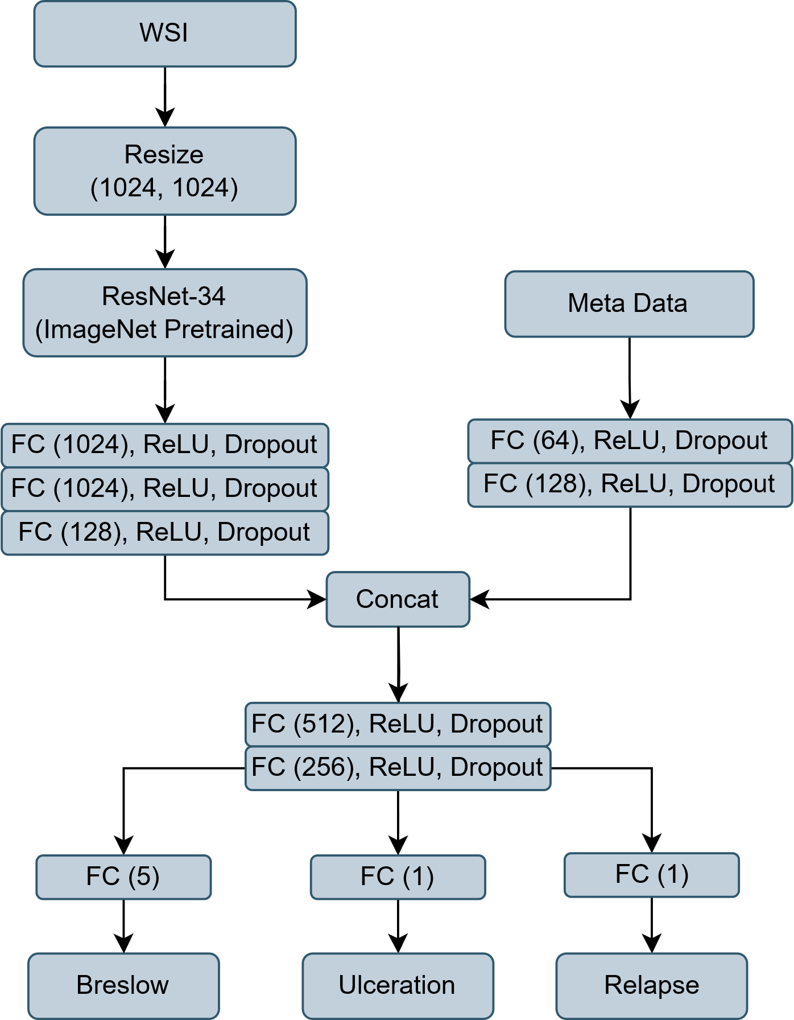
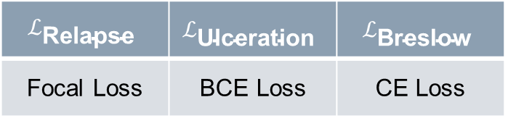
Methodologies
Whole Slide Model Single Stage Approach
Formulate the problem as multi-task learning
Train with images and meta data
$$ℒ_{\text{Relapse}}$$ | $$ℒ_{\text{Ulceration}}$$ | $$ℒ_{\text{Breslow}}$$
Focal Loss | BCE Loss | CE Loss

Slide 21
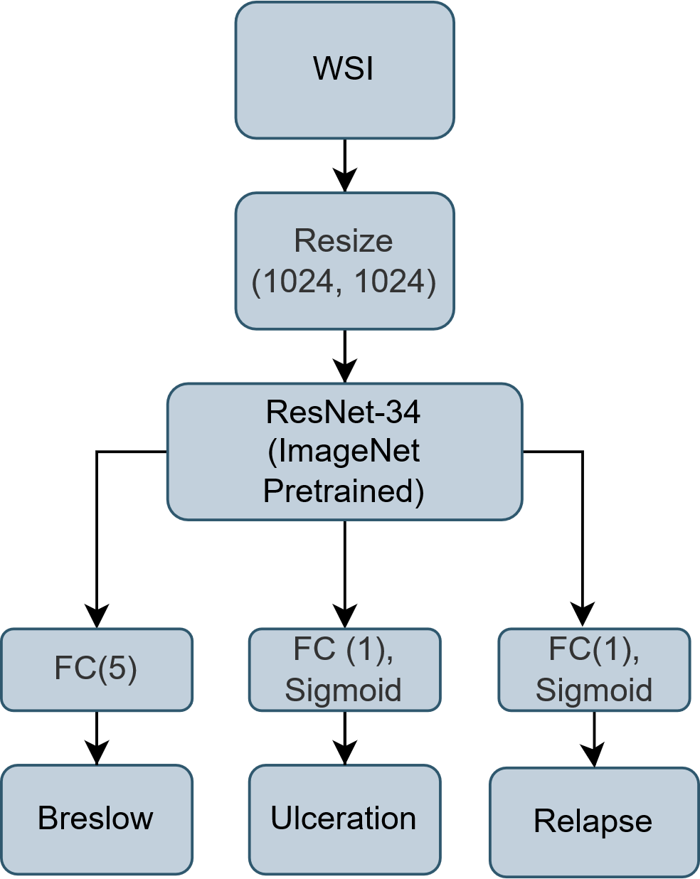
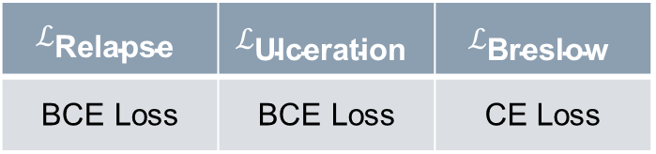
Methodologies
Whole Slide Model Two Stage Approach
Divided the problem into two stages, use multi-task learning approach.
Stage 1
Train only with images.
$$ℒ_{\text{Relapse}}$$ | $$ℒ_{\text{Ulceration}}$$ | $$ℒ_{\text{Breslow}}$$
BCE Loss | BCE Loss | CE Loss

Slide 22
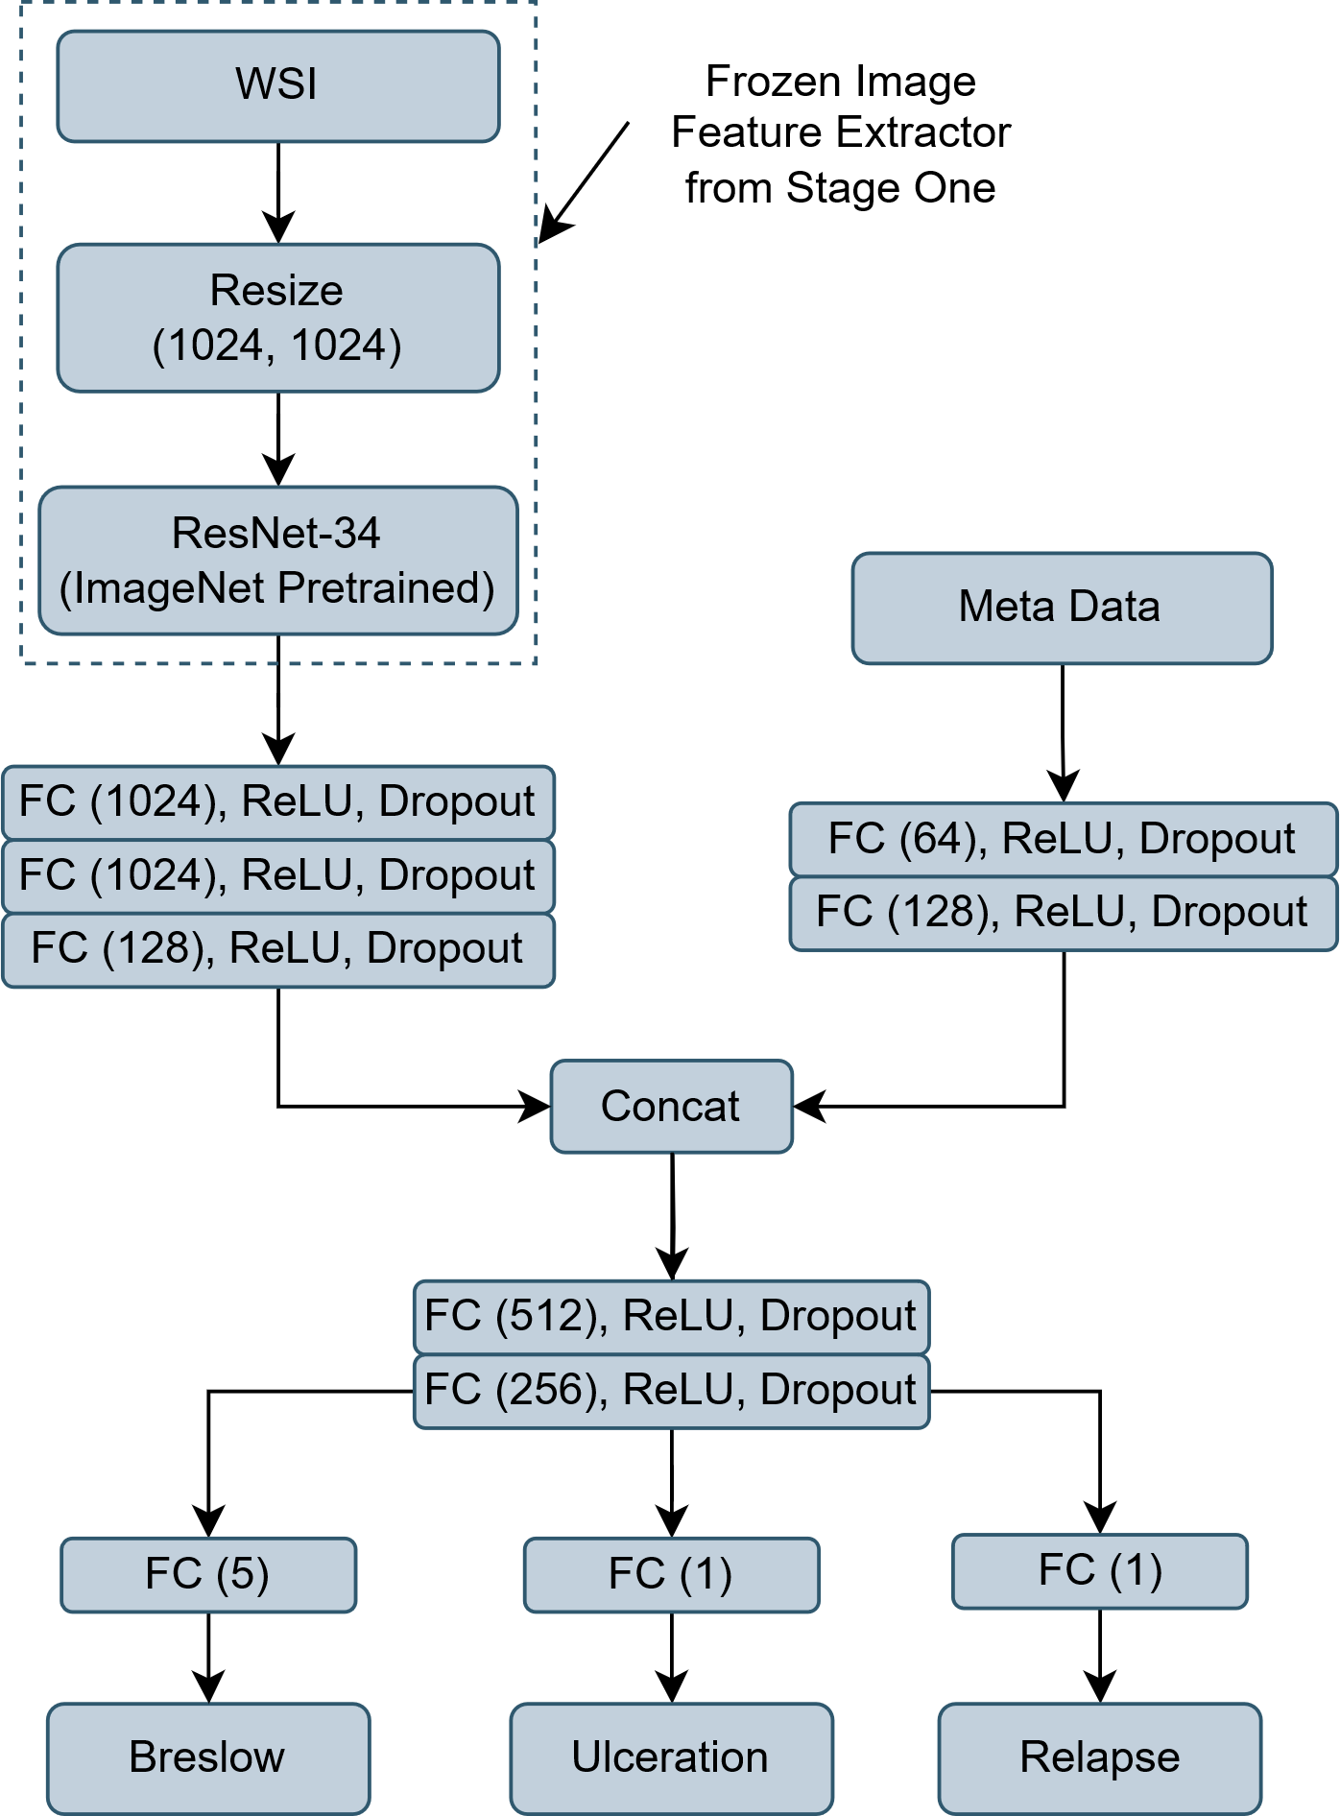
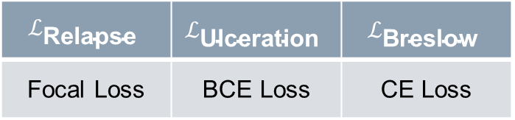
Methodologies
Whole Slide Model Two Stage Approach
Stage 2
Pretrained model from stage 1 used as feature extractor from images.
Train with image features and meta data
$$ℒ_{\text{Relapse}}$$ | $$ℒ_{\text{Ulceration}}$$ | $$ℒ_{\text{Breslow}}$$
Focal Loss | BCE Loss | CE Loss

Slide 23
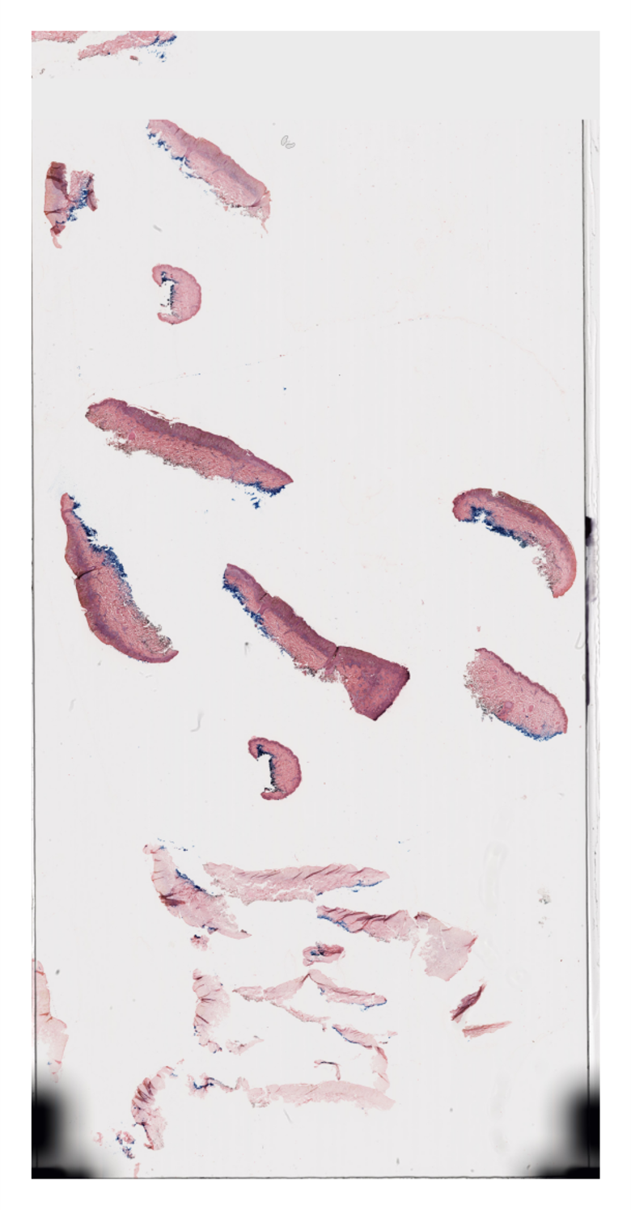
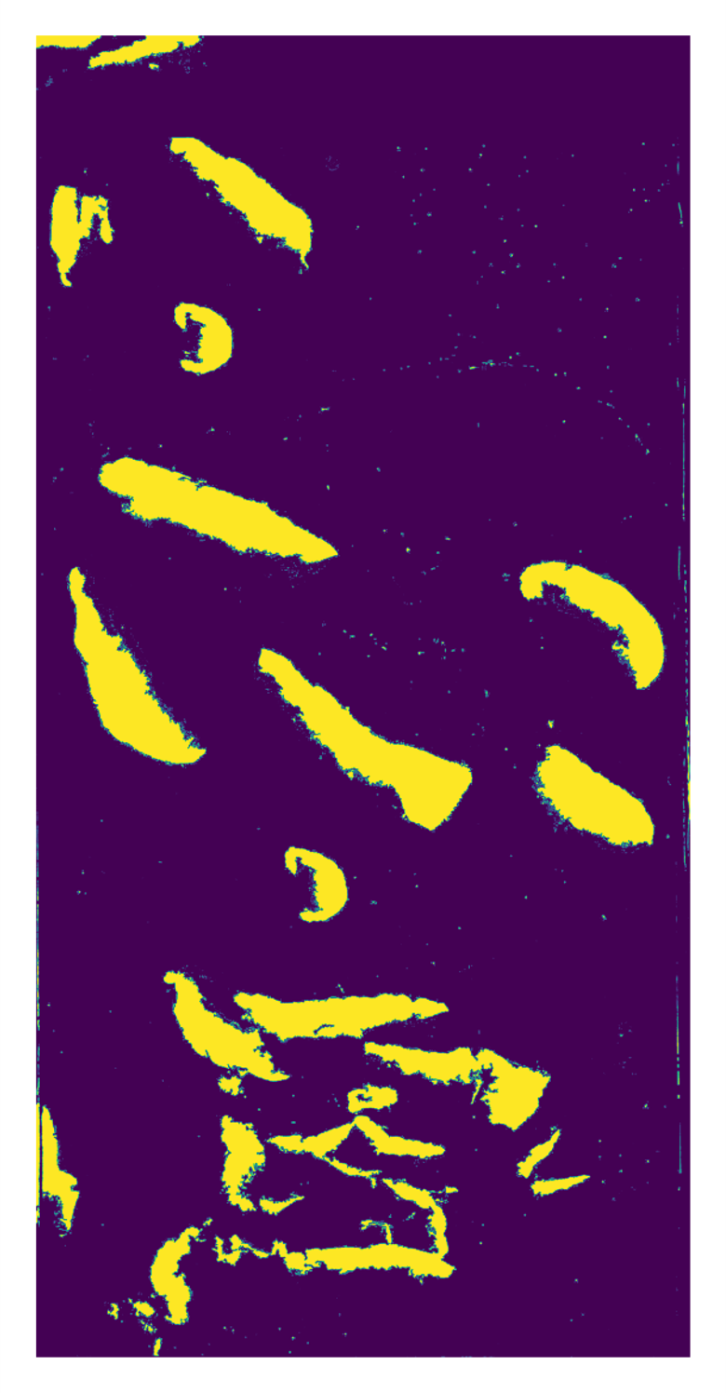
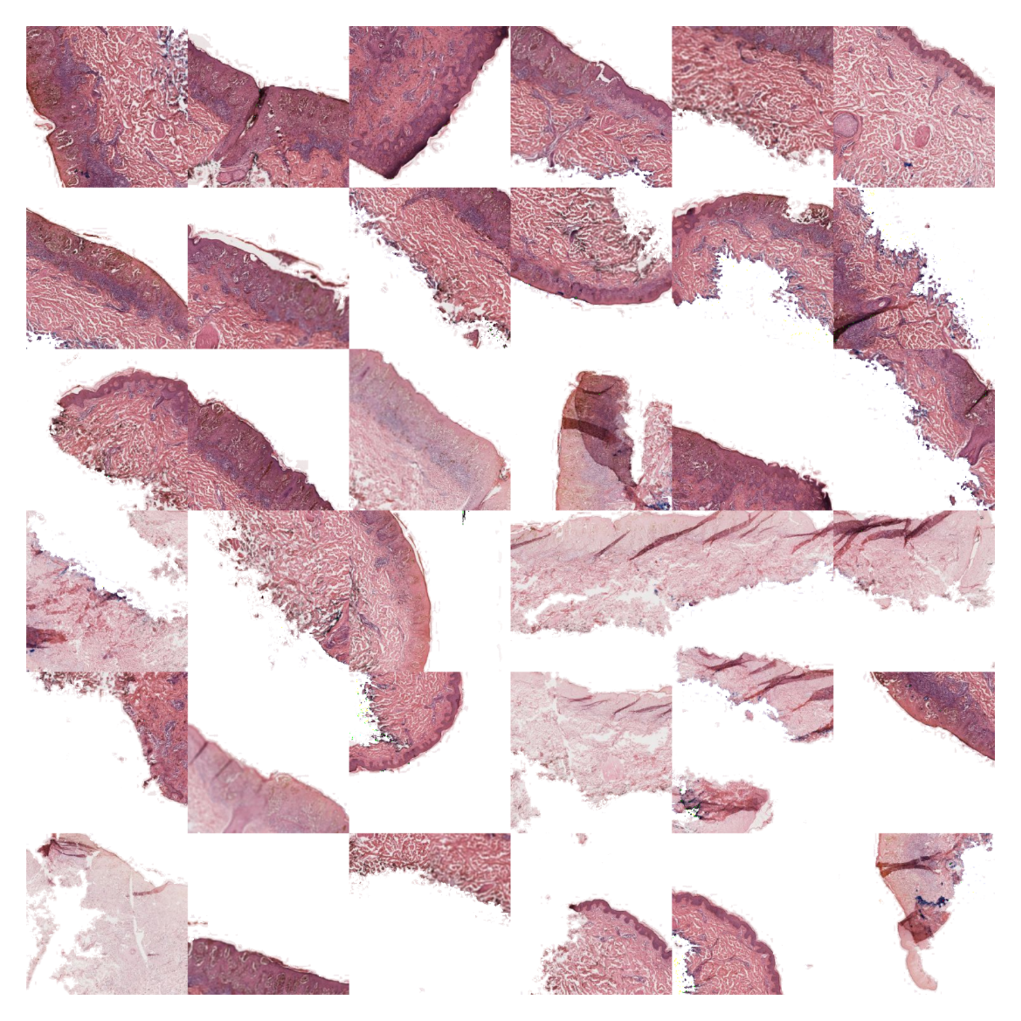
Methodologies
Patch Based Model
Exploit the fact that Tissue Areas in the WSI is very less
Extract Mask
Extract and Concat tiles
WSI to Tiled image (Tiling)

Slide 24
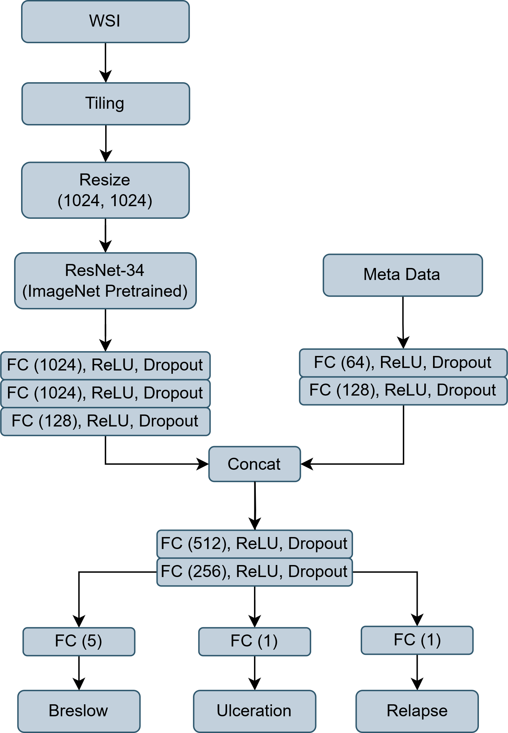
Methodologies
Patch Based Model Single Stage Approach
Same as WSI model with additional tiling step
$$ℒ_{\text{Relapse}}$$ | $$ℒ_{\text{Ulceration}}$$ | $$ℒ_{\text{Breslow}}$$
Focal Loss | BCE Loss | CE Loss

Slide 25
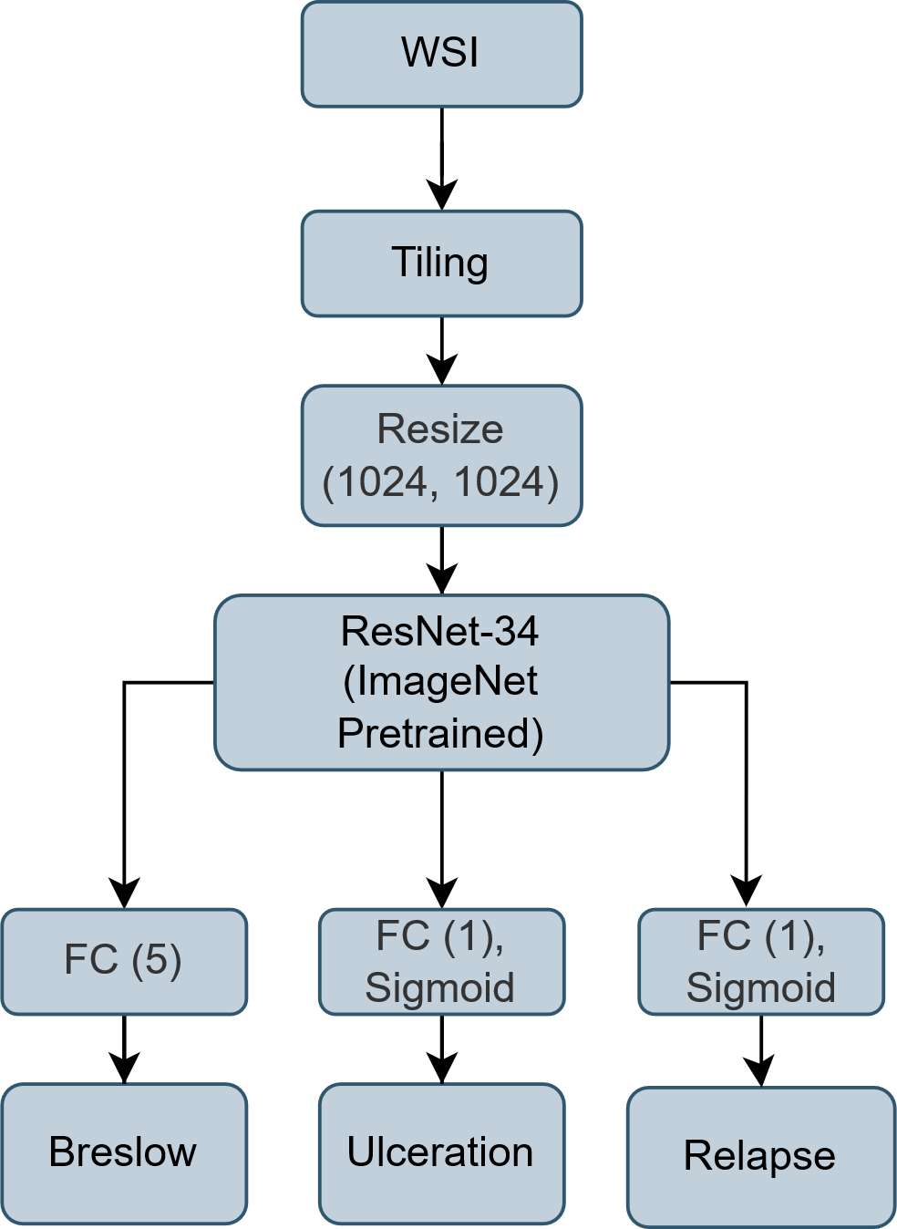
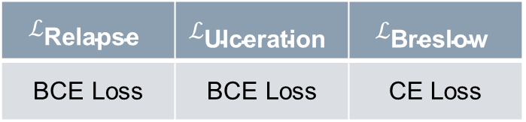
Methodologies
Patch Based Model Two Stage Approach
Stage 1
Same as WSI model
Additional tiling step
$$ℒ_{\text{Relapse}}$$ | $$ℒ_{\text{Ulceration}}$$ | $$ℒ_{\text{Breslow}}$$
BCE Loss | BCE Loss | CE Loss

Slide 26
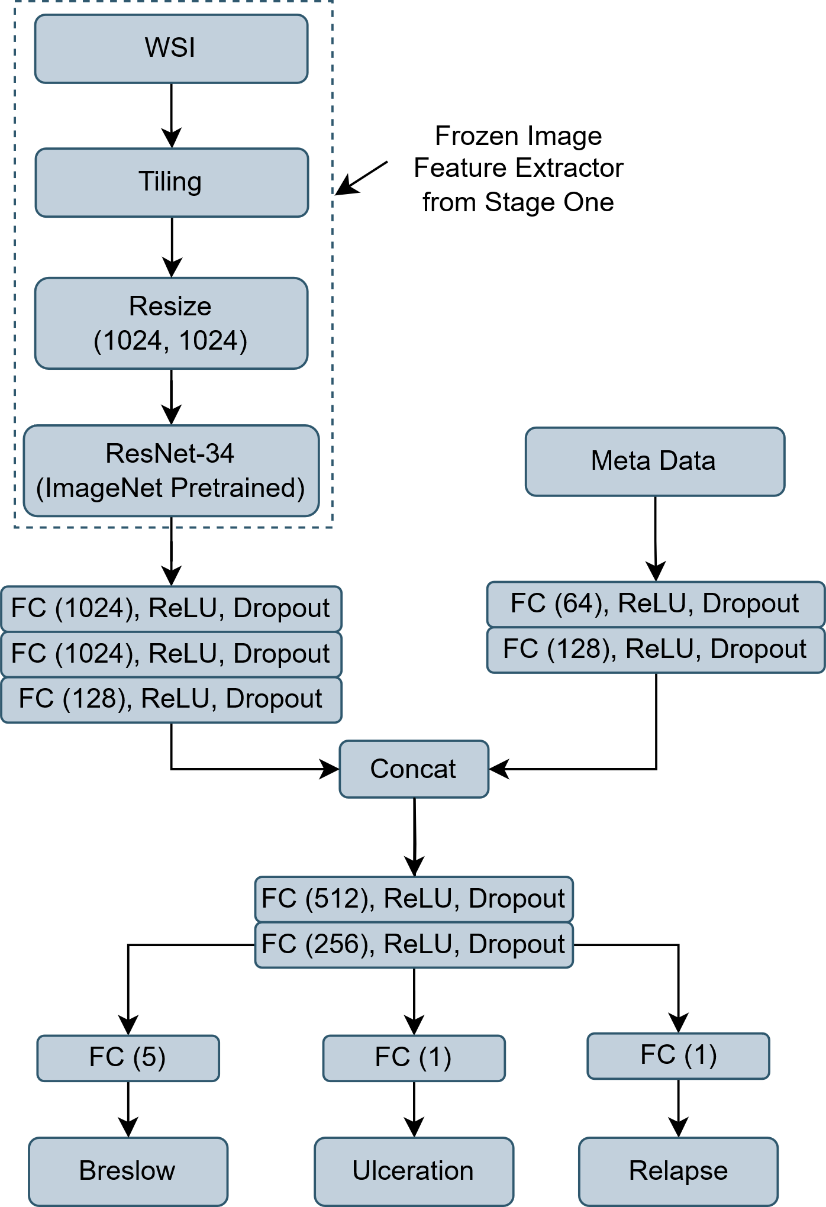
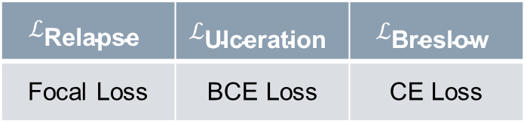
Methodologies
Patch Based Model Two Stage Approach
Stage 2
Same as WSI model but with tiling in image feature extractor
$$ℒ_{\text{Relapse}}$$ | $$ℒ_{\text{Ulceration}}$$ | $$ℒ_{\text{Breslow}}$$
Focal Loss | BCE Loss | CE Loss

Slide 27
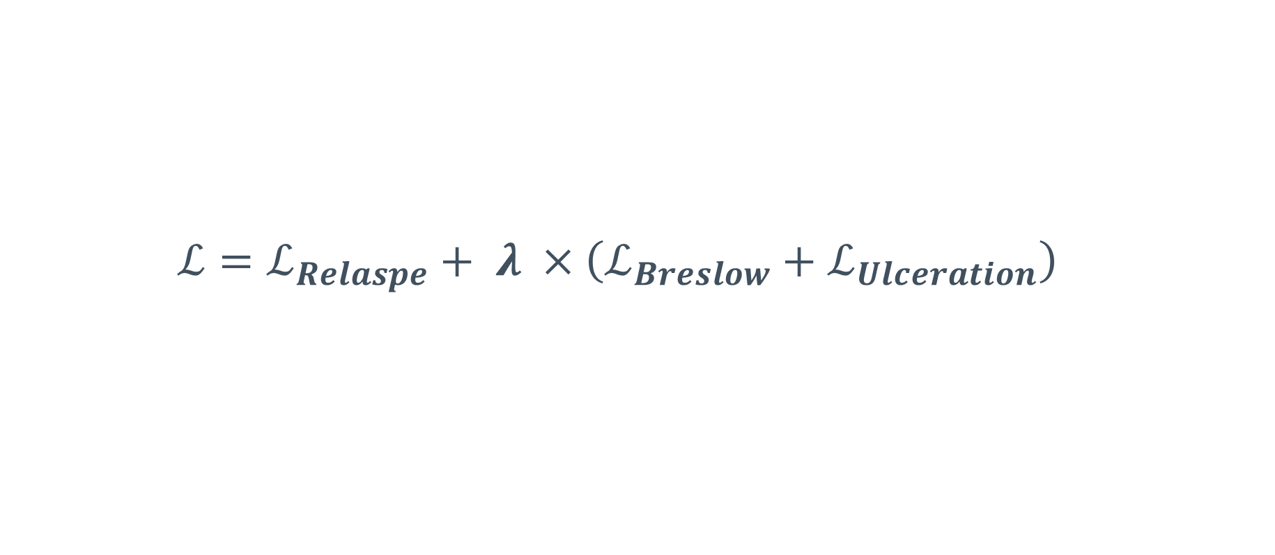
Methodologies
Loss Function
$$ℒ=ℒ_{Relaspe}+ λ ×\left(ℒ_{Breslow}+ℒ_{Ulceration}\right)$$

Slide 28
Methodologies
Base Model
Dropped Breslow and Ulceration from training data
Predicted relapse from meta data through classical machine learning models using Autogluon
Age
Sex
Model
Relapse
Yes/No
Body Site
Melanoma History

Slide 29
04 Evaluation

Slide 30
Evaluation
Metrics | Base Model | Single Stage WSI Model | Two Stage WSI Model | Single Stage Stitched Model | Two Stage Stitched Model
Accuracy (↑) | 0.74 | 0.71 | 0.74 | 0.8 | 0.76
Recall (↑) | 0.55 | 0.7 | 0.76 | 0.76 | 0.77
Precision (↑) | 0.54 | 0.62 | 0.66 | 0.68 | 0.67
F1 Score (↑) | 0.55 | 0.62 | 0.66 | 0.7 | 0.68
ROC_AUC (↑) | 0.6 | 0.79 | 0.82 | 0.81 | 0.81
TNR (↑) | 0.82 | 0.72 | 0.73 | 0.81 | 0.76
TPR (↑) | 0.28 | 0.67 | 0.79 | 0.7 | 0.79
FNR (↓) | 0.72 | 0.33 | 0.21 | 0.3 | 0.21
FPR (↓) | 0.18 | 0.28 | 0.27 | 0.19 | 0.24

Slide 31
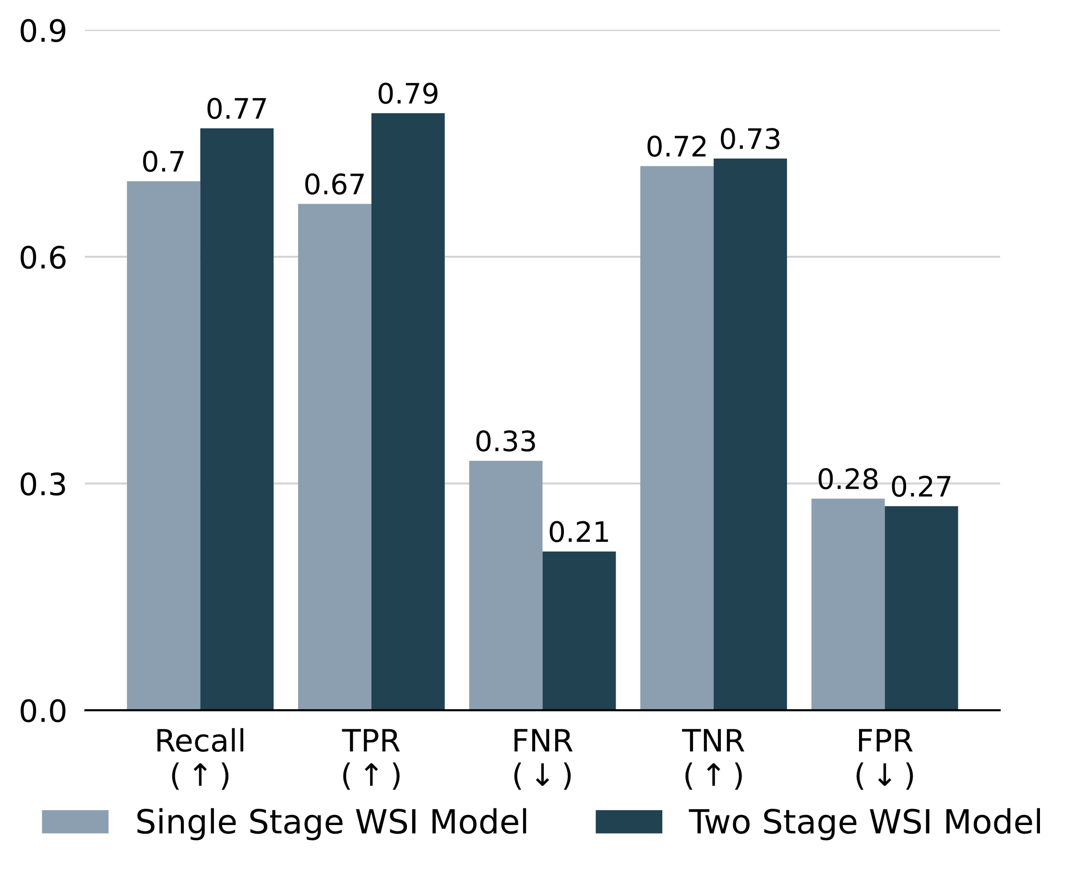
Evaluation

Slide 32
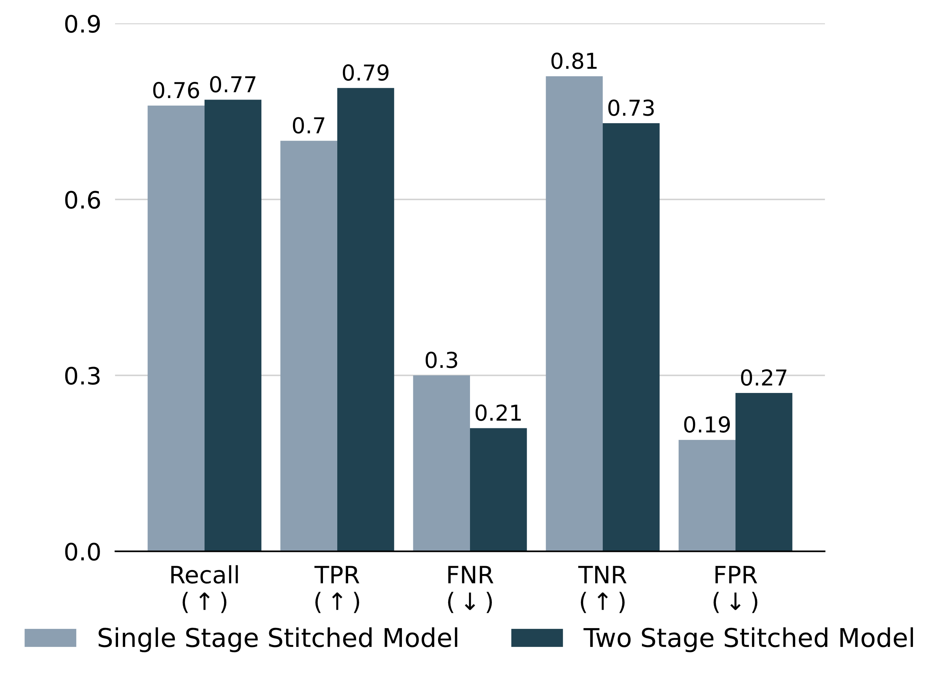
Evaluation

Slide 33
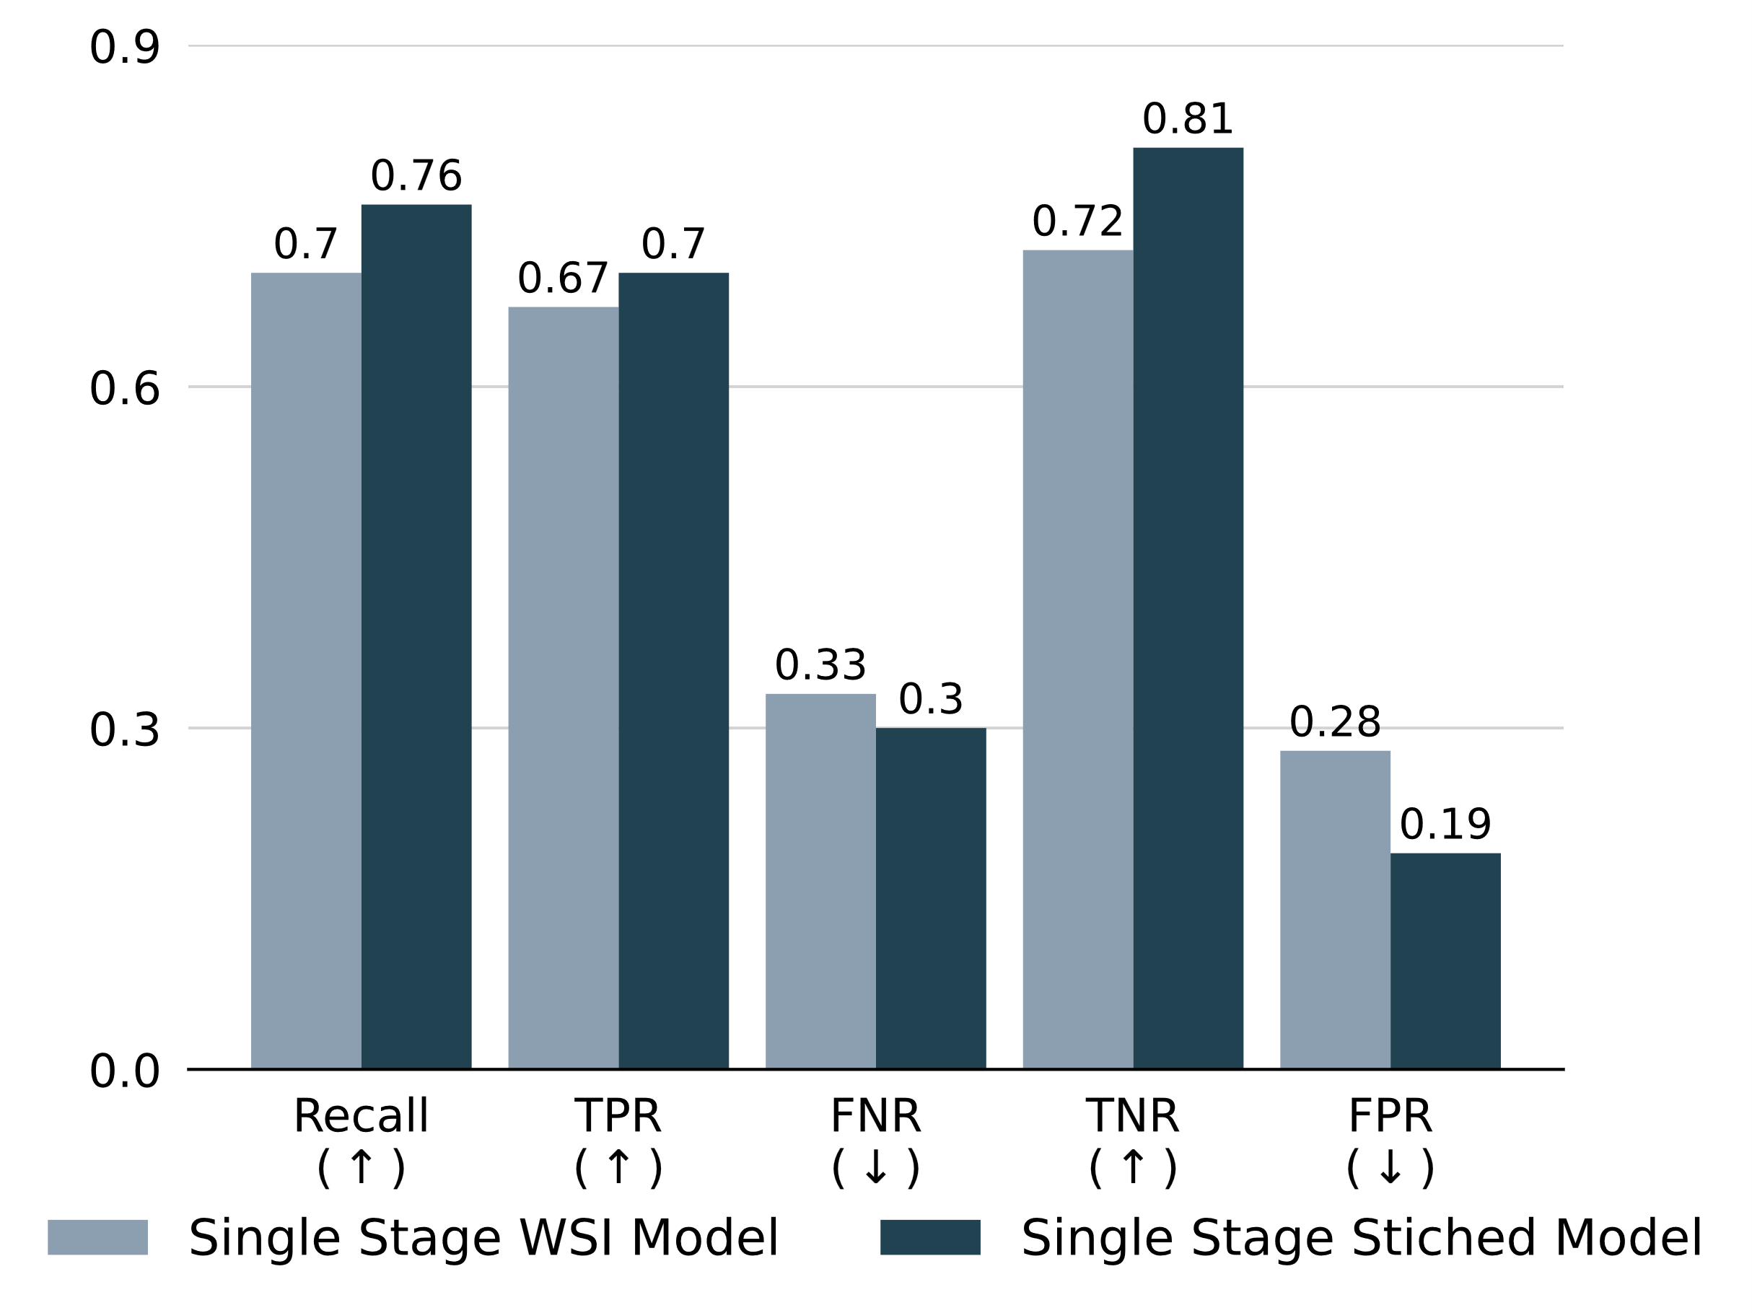
Evaluation

Slide 34
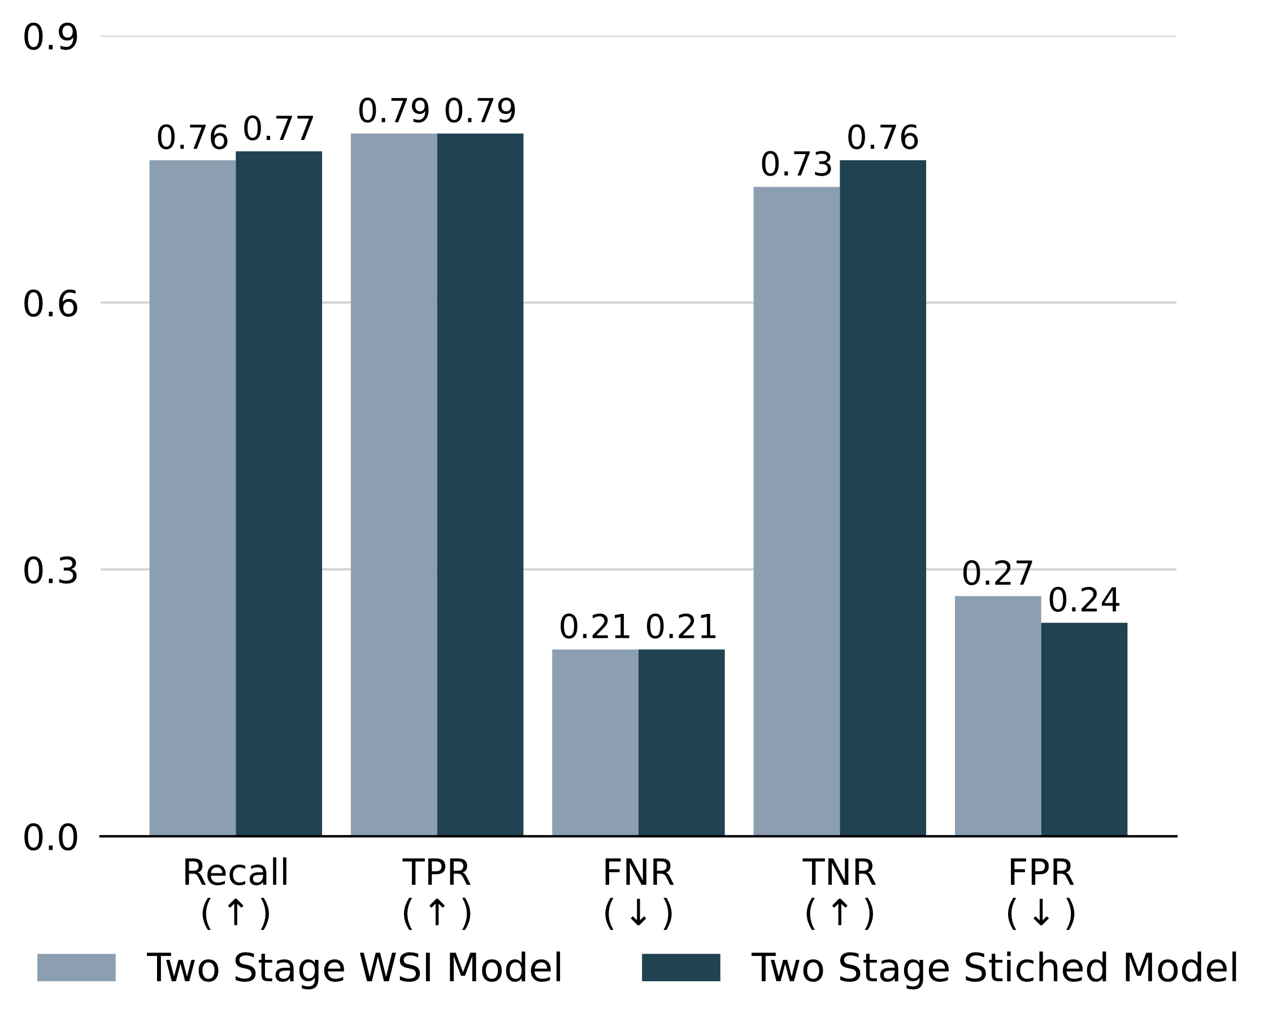
Evaluation

Slide 35
05 Conclusion & Future Work

Slide 36
Conclusion & Future Work
Conclusion
One ML method and 4 multimodal DL methods were tried, DL methods perform better than the ML method.
Should we train with WSI and tabular data together (single stage) or one after the other (two stages)?
Two Stage strategy performs better than the Single Stage strategy.
Should Patches from WSI be preferred over WSI for training?
Converting the Whole Slide Images (WSI) into stitched tiles improves the results.

Slide 37
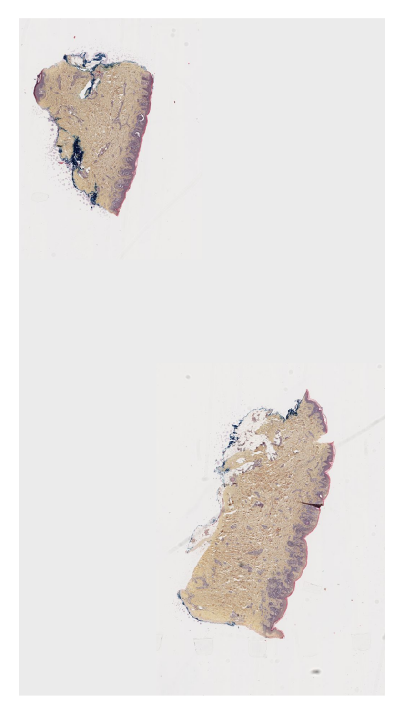
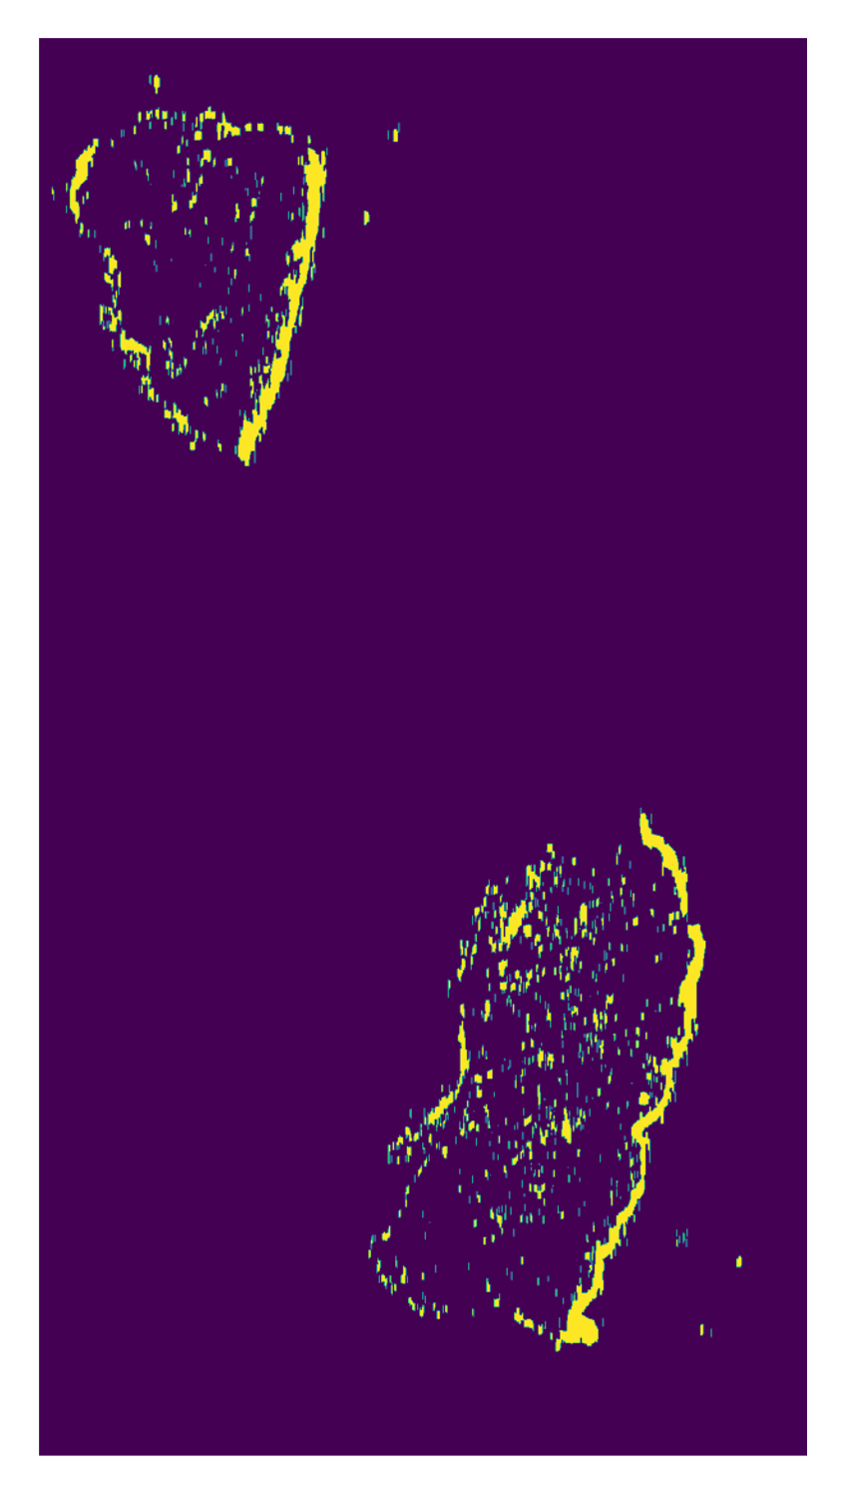
Conclusion & Future Work
Future Work
Better Segmentation mask for Tissue and Non-Tissue regions
Ensemble of WSI and stitched method may help
Structure preserving stitching might improve the results
WSI Model
Stitched Model
Ensemble
Relapse Yes/No
current
improvement

Slide 38
Thank you for your attention
Questions?

